Slide 1
Thinking, Control, Intelligence
Randall C. O’Reilly

Slide 2
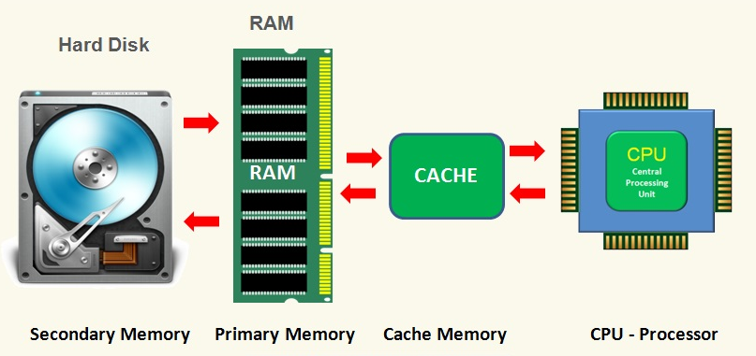
What is Smart?
It is easy to identify what makes a computer smarter:
* Faster
* More memory

Slide 3

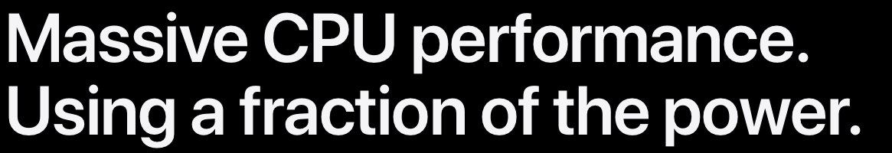
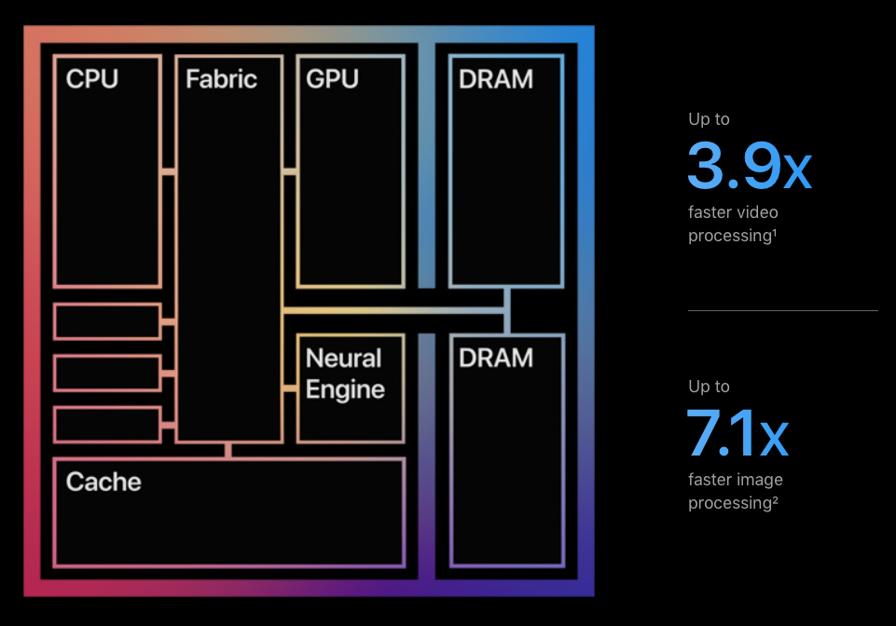
What is Smart?
It is easy to identify what makes a computer smarter:
* Faster
* More memory

Slide 4
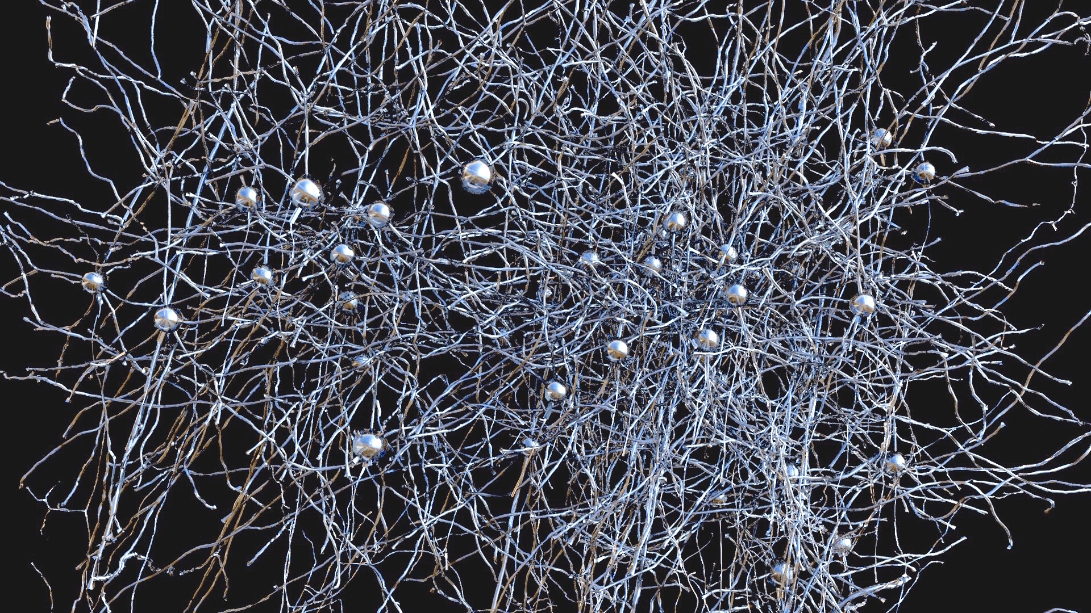
But what about the brain?
Do smarter people have more neurons? More synapses?
We actually lose synapses over development..

Slide 5
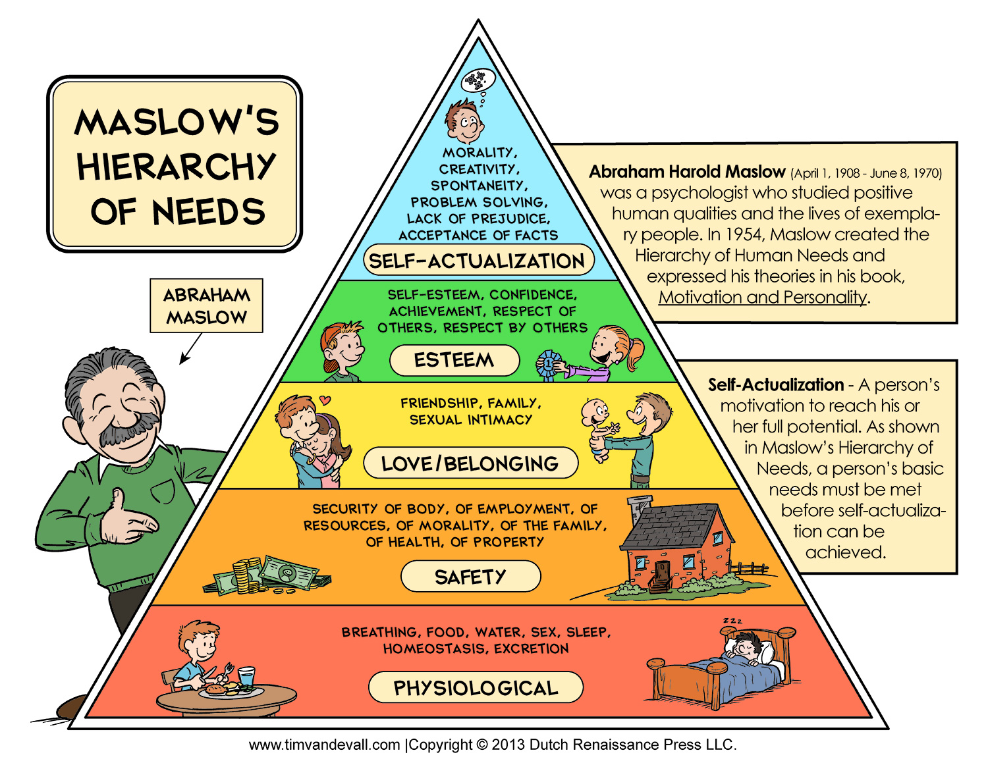
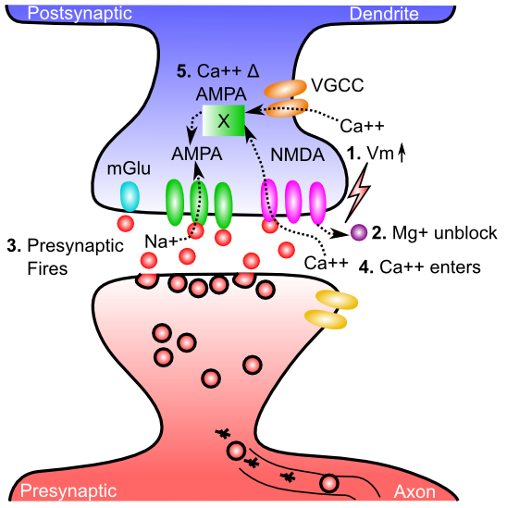
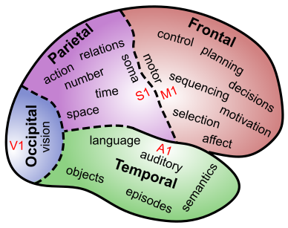
But what about the brain?
Most of what we can do, we learn, and learning is driven by motivation..

Slide 6
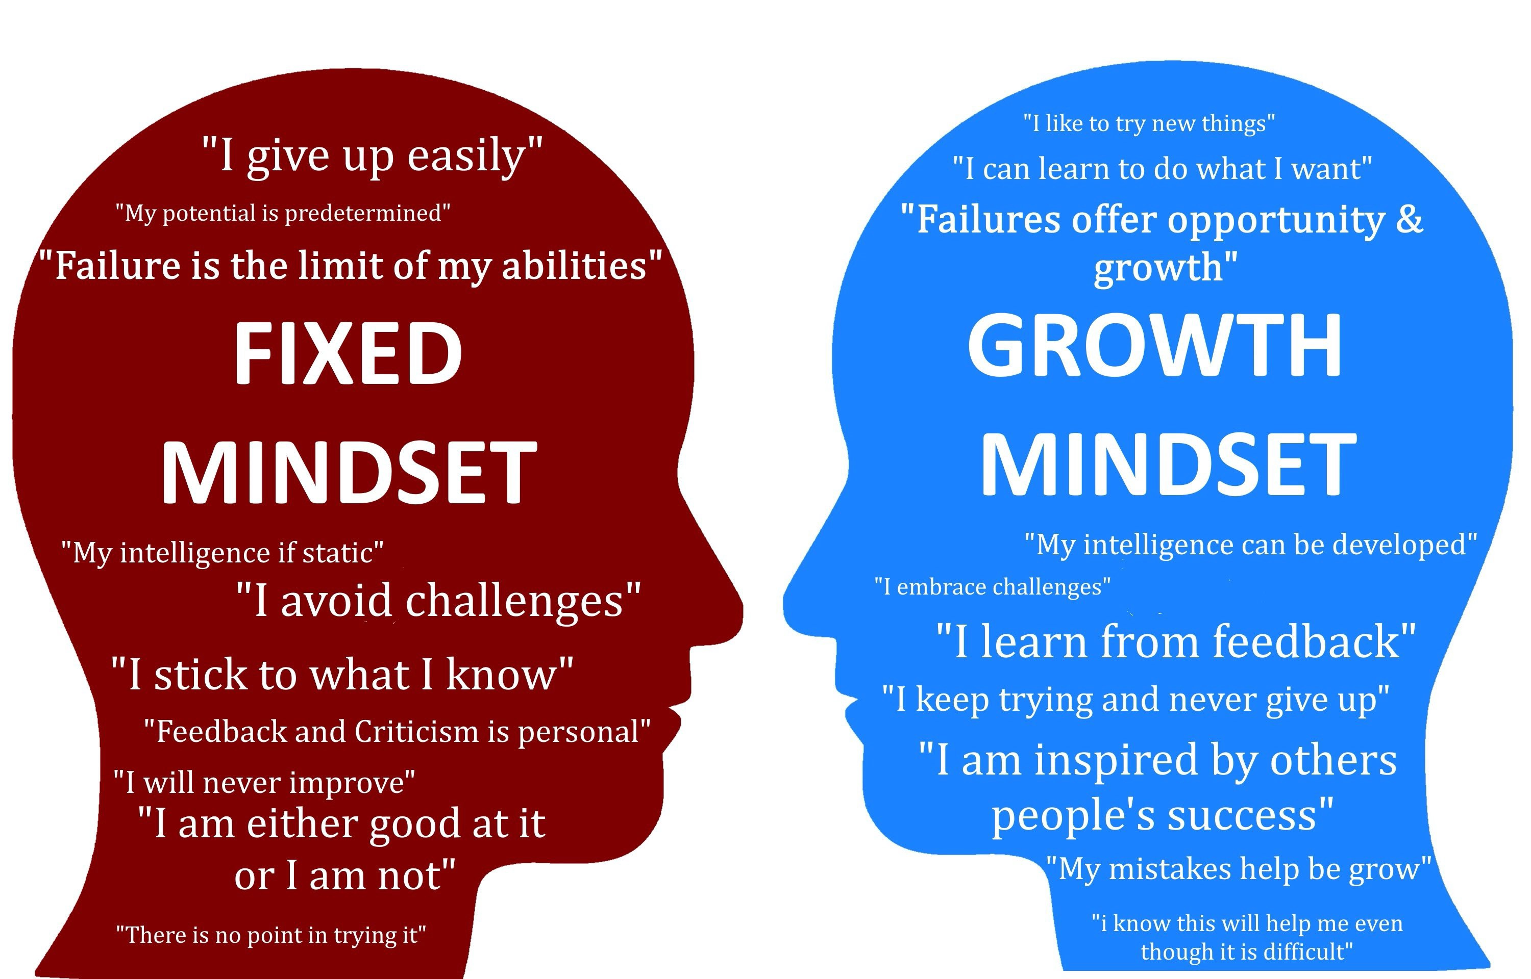

Slide 7
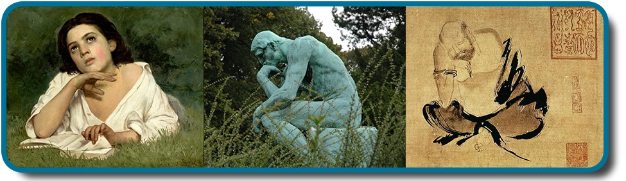
What is “Thinking”?
* Conscious manipulation of knowledge
* Takes time, and concentration: multi-step
* Focused on solving problems

Slide 8
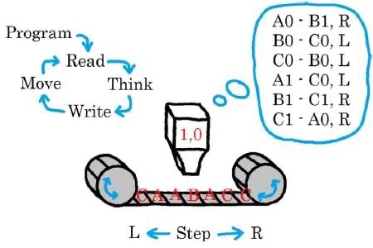
Information Processing: CPU
Turing Machine:

Slide 9
Algorithm
Precise set of step-by-step operations to perform, to process information: take input, do computation, produce output..

Slide 10
Neural CPU = Turing Machine
Program: actual human language (e.g., English): talk yourself through it..
Active memory: prefrontal cortex working memory
Memory storage and retrieval (tape): hippocampal memory system (or a piece of paper!)

Slide 11
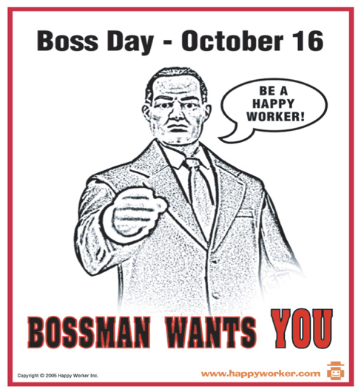
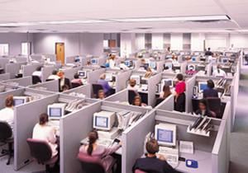
PFC = Control, Working Memory

Slide 12
PFC = Top-Down Biasing

Slide 13
Stroop Task: Top Down Biasing
RED

Slide 14
Stroop Task: Top Down Biasing
GREEN

Slide 15
Stroop Task: Top Down Biasing
RED

Slide 16
Stroop Task: Top Down Biasing
GREEN

Slide 17
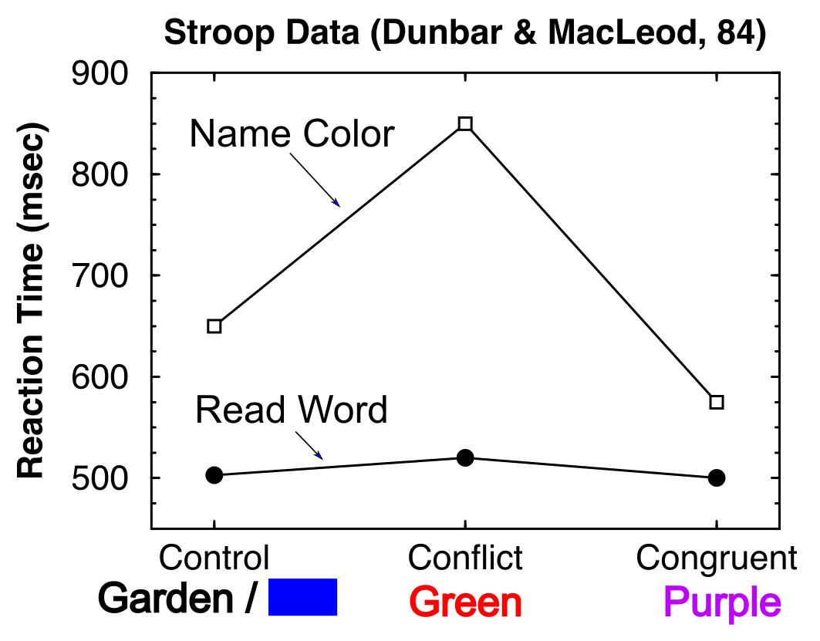
Reading is Automatic Color Naming needs Control

Slide 18
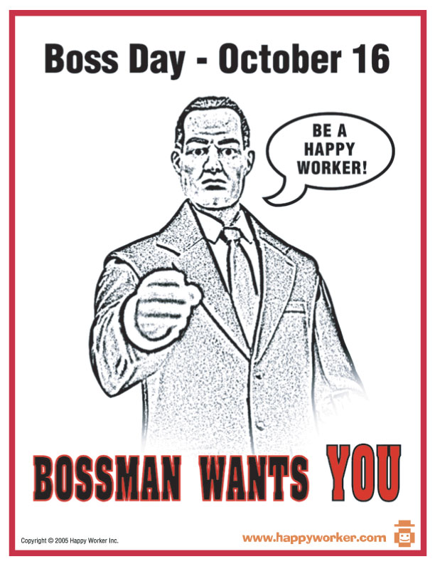
Key Idea: Top-Down Biasing
“Name colors you idiots!”
“But we prefer reading (Facebook..)”

Slide 19
System 1, 2 (Kahneman)
System 1: posterior cortex – domain-specific knowledge and fast processing
Previously known as automatic processing
System 2: prefrontal cortex – general purpose cognitive processing and problem solving (slow)
Previously known as controlled processing
(It takes a Nobel prize to reinvent a well-established distinction, using much worse terms!)

Slide 20
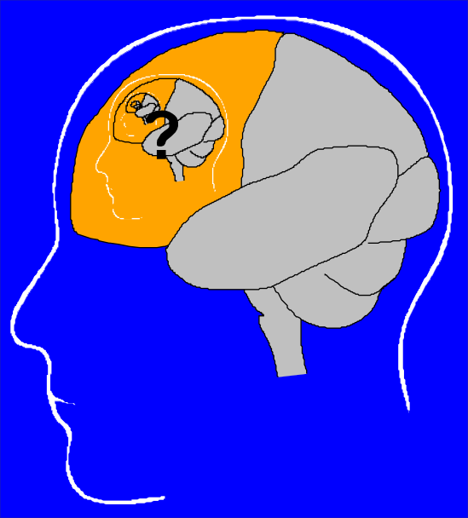
The Homunculus Problem

Slide 21
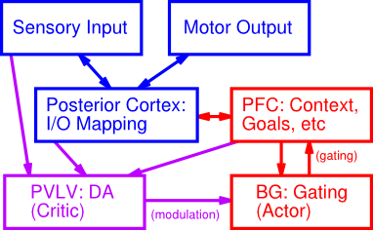
It Takes a Network..

Slide 22
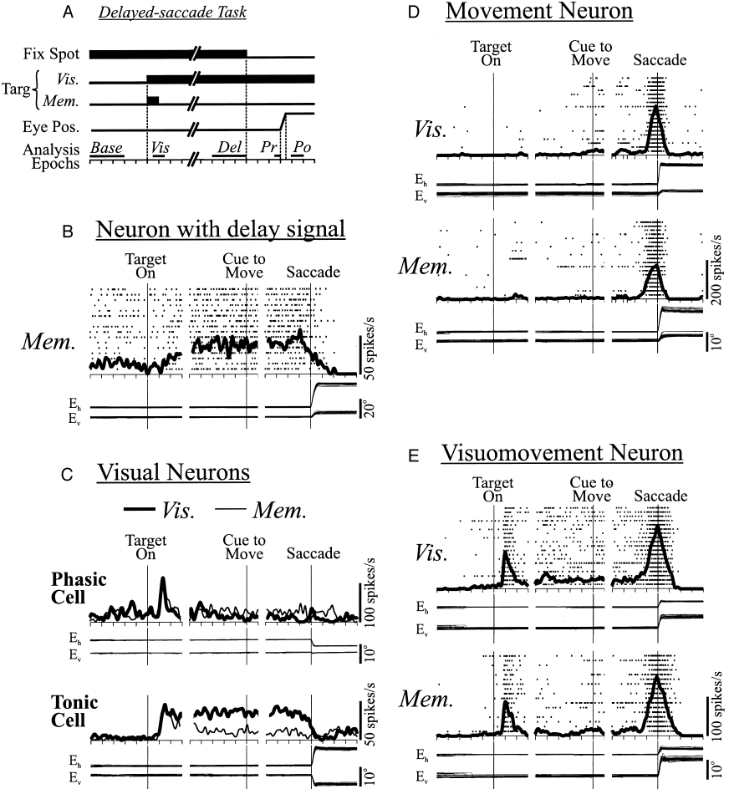
PFC Does Active Maintenance

Slide 23
Active Maintenance Can Do it All
Cognitive Control
Maintained activity drives top-down biasing
Planning
Think about things that are not there (future)
Motivation
Maintain goals
Reward processing
Maintain possible outcomes
Decision making
Maintain alternatives

Slide 24
Basal Ganglia Controls Program Flow
Production system
(ACT-R; Anderson et al)

Slide 25
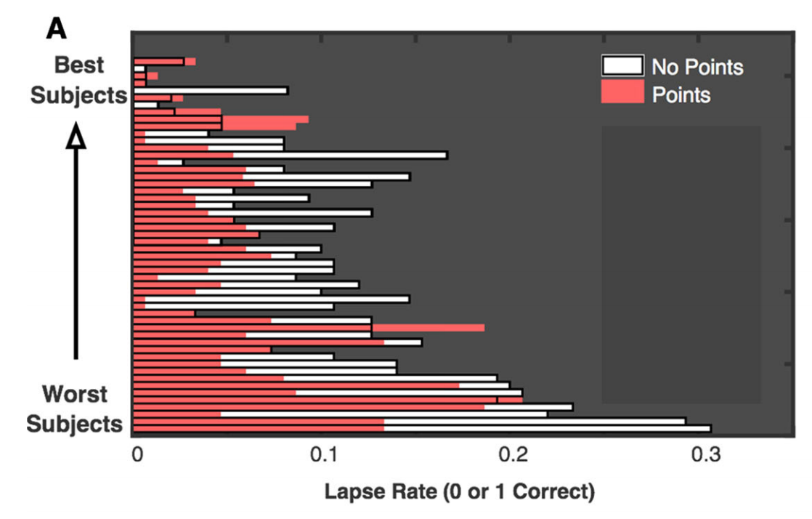
Motivation and Working Memory (Adam & Vogel, 2016)
Raw “MAX” working memory capacity does NOT differ between subjects
What DOES differ is rate of tuning out / lapsing!
Miyake: Class grades predicted by mind-wandering, procrastination!

Slide 26
More Dichotomies
System 1 = Automatic = Crystalized Intelligence = posterior cortex with well-tuned synapses over a lifetime of experience (wise..)
System 2 = Controlled = Fluid Intelligence = prefrontal cortex & basal ganglia with strong ability to rapidly update and maintain information in working memory

Slide 27
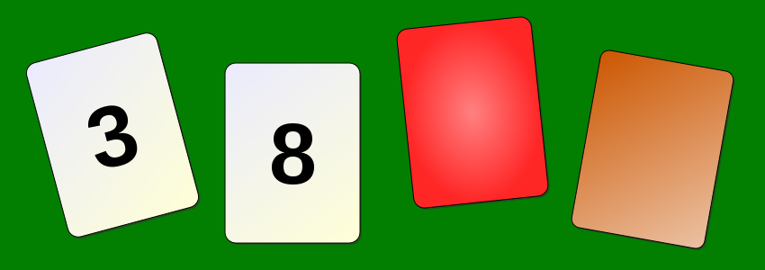
Wason Card Selection
Cards have number on one side, color on other.
You need to test whether the following rule is true:
If there is an even number on one side, then the other side is red. Which to turn over?

Slide 28

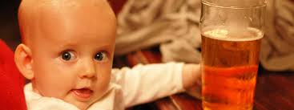
Brain Loves Concrete, not Abstract
Rule: If you are drinking alcohol, you must be over 21. Who do you card?

Slide 29
Cognitive Biases, Heuristics
We use simple, concrete, shortcuts to reason, instead of complicated logic, statistics
Heuristic: shortcuts, “rule of thumb”

Slide 30
Availability Heuristic
Whatever comes to mind, go with that! Much easier than figuring out the actual statistics!
Problem: not very accurate..

Slide 31
What is Greatest Risk?
A. Nephritis, nephrotic syndrome, nephrosis
B. Airplane crash

Slide 32
Actual Stats: http://www.cdc.gov/nchs/fastats/leading-causes-of-death.htm
Cause Number % Rate per 100,000
... All causes 2,596,993 100.0 821.5
1 Diseases of heart 611,105 23.5 193.3
2 Cancer 584,881 22.5 185.0
3 Chronic lower respiratory 149,205 5.7 47.2
4 Accidents 130,557 5.0 41.3
5 Cerebrovascular diseases 128,978 5.0 40.8
6 Alzheimer's disease 84,767 3.3 26.8
7 Diabetes mellitus 75,578 2.9 23.9
8 Influenza and pneumonia 56,979 2.2 18.0
9 Nephritis, etc 47,112 1.8 14.9
10 Suicide 41,149 1.6 13.0
… Airplane crashes 59

Slide 33
Representative Heuristic
Compare how similar to a prototypical case
Problem: tend to ignore base rates.
And rely on stereotypes

Slide 34
Linda..
Linda is 31 years old, single, outspoken, and very bright. She majored in philosophy. As a student, she was deeply concerned with issues of discrimination and social justice, and also participated in anti-nuclear demonstrations.
Which is more probable?
A. Linda is a bank teller.
B. Linda is a bank teller and is active in the feminist movement.

Slide 35
Confirmation Bias CCC = Control!
Only pay attention to information consistent with our preexisting beliefs!
Astrology, politics, .. Everywhere!
Filter bubble = more and more of a problem in modern digital media!
Belief Persistence: just plain ignore / discredit inconsistent information!
Why? Our beliefs are central to our feeling of control and identity: challenge is very threatening!

Slide 36
Gambler’s Fallacy
Belief that: If you’ve just been losing, you’re more likely to win! (Or vice-versa)
But, probability of heads is always 50% no matter how many heads or tails have come before!
Interestingly: probability over time of HH vs HT is NOT the same!! This is likely basis of this fallacy.
https://www.pnas.org/content/early/2015/03/05/1422036112

Slide 37
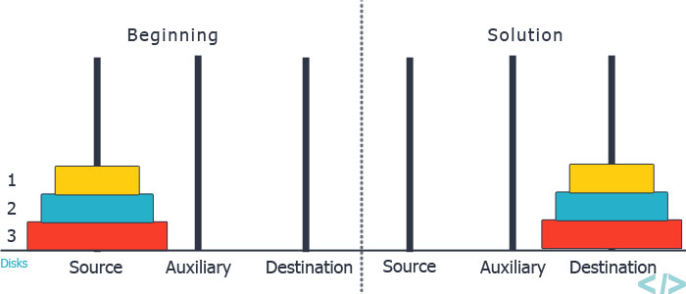
Problem Solving
Trial and Error: try and see what works..
Hill climbing: make current state closer to target state – doesn’t always work though!

Slide 38

Thinking Outside the Box
Connect all of the dots using only 4 straight lines, without lifting up ‘pen’:
Mental set, functional fixedness: inside the box…

Slide 39
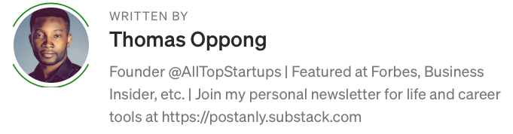
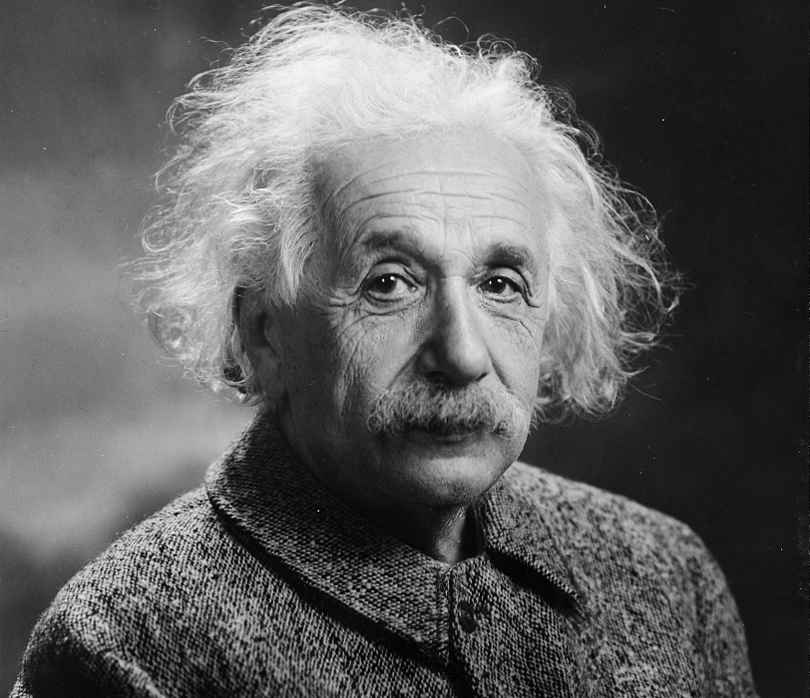
Who is Smart?
Genius Takes Time And Extraordinary Effort
Buckminster Fuller said, “I’m not a genius. I’m just a tremendous bundle of experience.”
Mozart had clocked up 3500 hours by the time he was 6 and had studied his chosen profession for 18 years before he wrote his Piano Concerto No 9 at the age of 21.
Tiger Woods started when he was 2 years old. Serena Williams started playing at 3, Venus Williams at 4. They committed to deep, sustained immersion in purposeful practice.

Slide 41
IQ Scales and History
Stanford-Binet: first IQ test (Alfred Binet)
WAIS-III: Wechsler Adult Intelligence Scale: first IQ test for adults
Spearman: Indifference of the Indicator: “smart” people do well on any test: g = general IQ factor

Slide 42
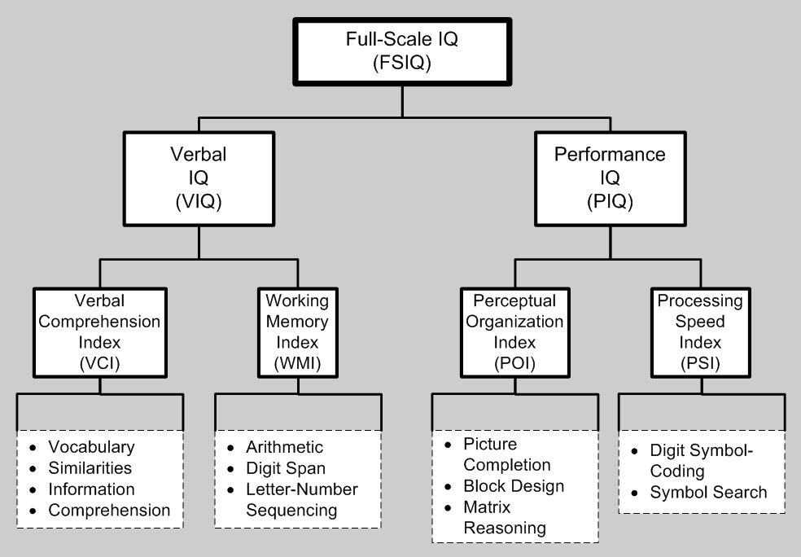
WAIS
Standardized: 100 = average
Reliability: test-retest
Predictive validity: IQ is single best predictor of grades, SAT tests, educational outcomes. Correlated with health. But not best predictor of job performance.

Slide 43
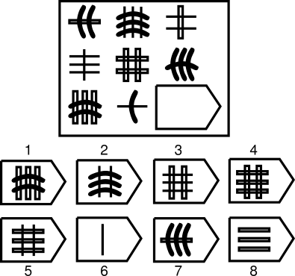
g = Raven’s Progressive Matricies

Slide 44
Multiple Intelligences
Thinking is located in every single synapse in the brain
There are as many different kinds of thinking as there are neurons and synapses and brain areas…

Slide 45
Multiple Intelligences
Sternberg: Triarchic = analytic, creative, practical
Carroll: Three-stratum (g, 8 more specific, and then 69 even more specific)
Fluid intelligence (Gf = PFC, g) vs. Crystallized (Ge = posterior cortex, knowledge, wisdom)

